Slide 1
www.dessled.com
AMBIENT CREATOR
DESS
DESSGLSLED
Last Edited : 30/10/2024

Slide 2
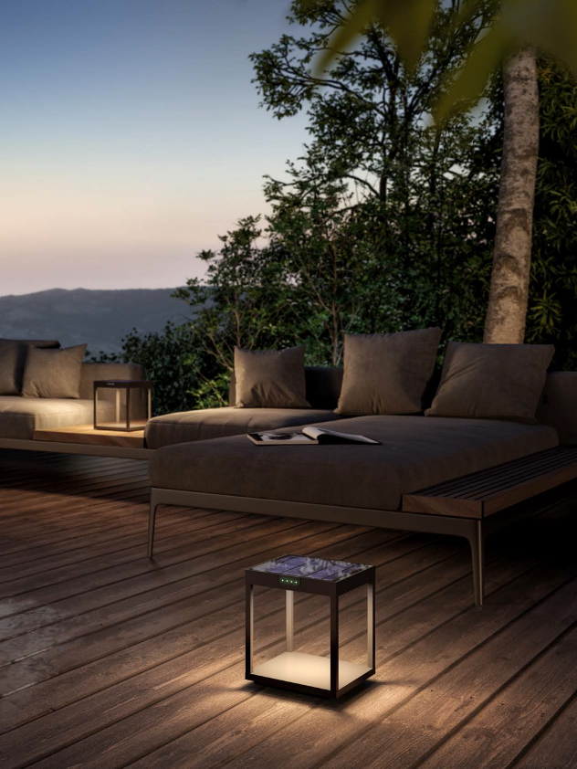
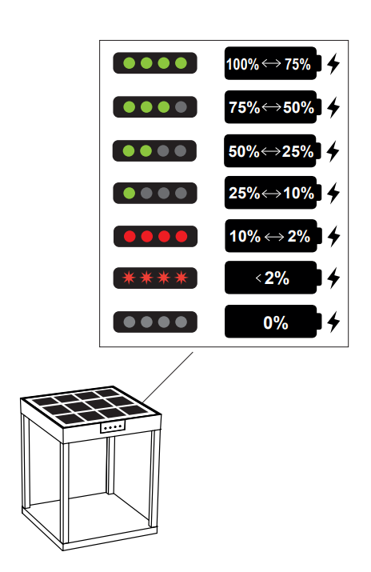
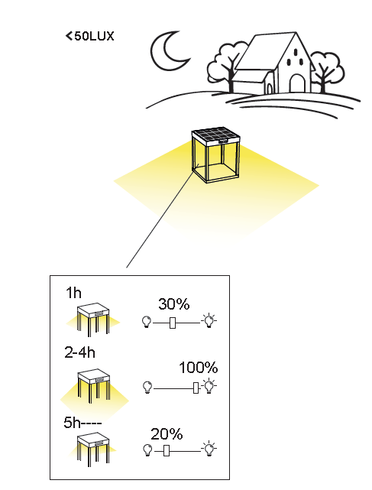
1130110
RADIA GROUND LED SOLAR LAMP DIE CAST ALUMINUM POWDER COATED TO DARK GREY
LIGHT SOURCE : 3W
CHIP : Lumileds 4014
COLOR TEMP : 3000K
LUMEN : 236Lm - 100%
WORKING TEMP : -20˚C to 40˚C
CHARGING TIME : 8-10H
WORKING TIME : 23-25H
LITHIUM BATTERY : 4400mAh
SOLAR PANEL VOLTAGE : 4.5W 7V
CRI : Ra 80 IP : IP65
SIZE : 204 x 204 x H245mm

Slide 3
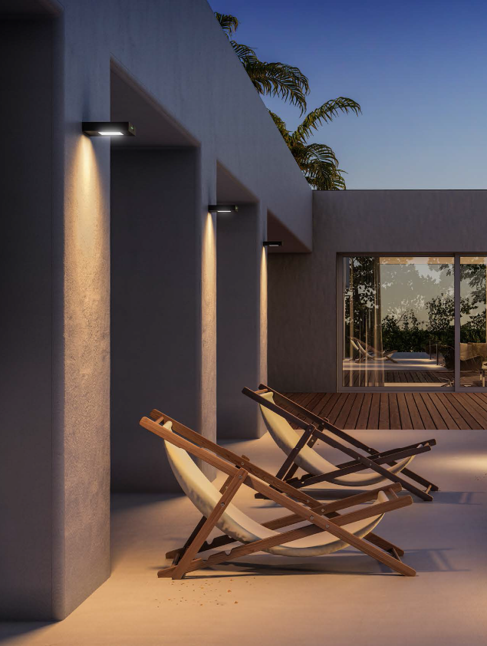
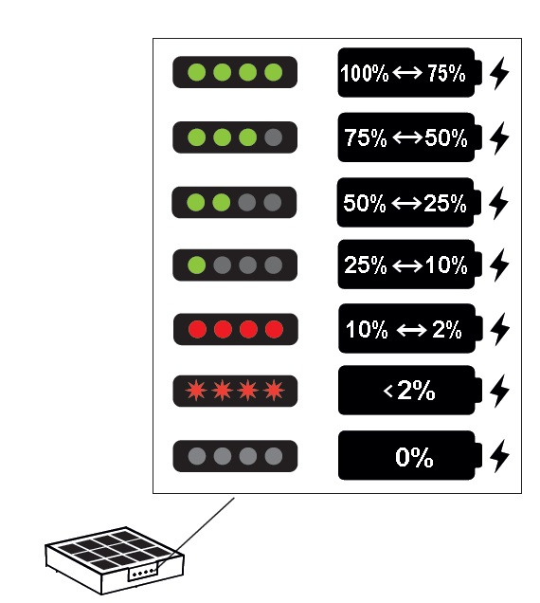
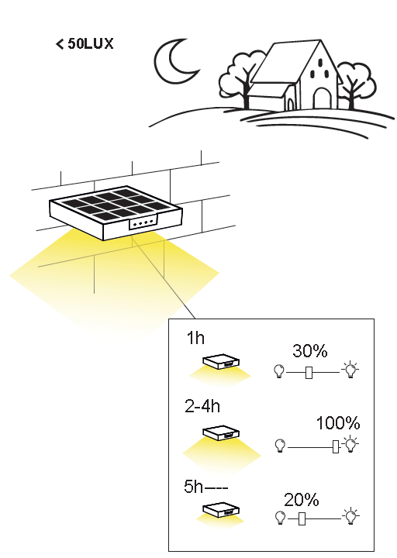
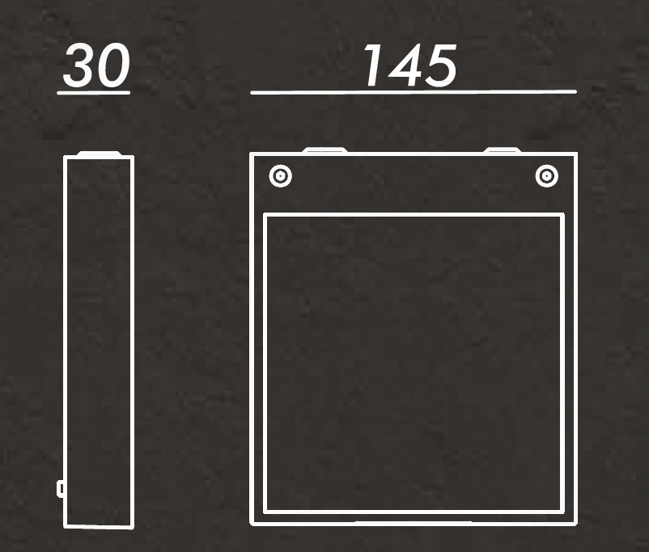
1160310
ALA WALL LED SOLAR LAMP DIE CAST ALUMINUM POWDER COATED TO DARK GREY
LIGHT SOURCE : 2.2W
CHIP : Lumileds 4014
COLOR TEMP : 3000K
LUMEN : 202Lm - 100%
WORKING TEMP : -20˚C to 40˚C
CHARGING TIME : 6-8H
WORKING TIME : 16-18H
LITHIUM BATTERY : 2200mAh
SOLAR PANEL VOLTAGE : 2.5W 7V
CRI : Ra 80 IP : IP65
SIZE : 145 x 165 x H30mm

Slide 4
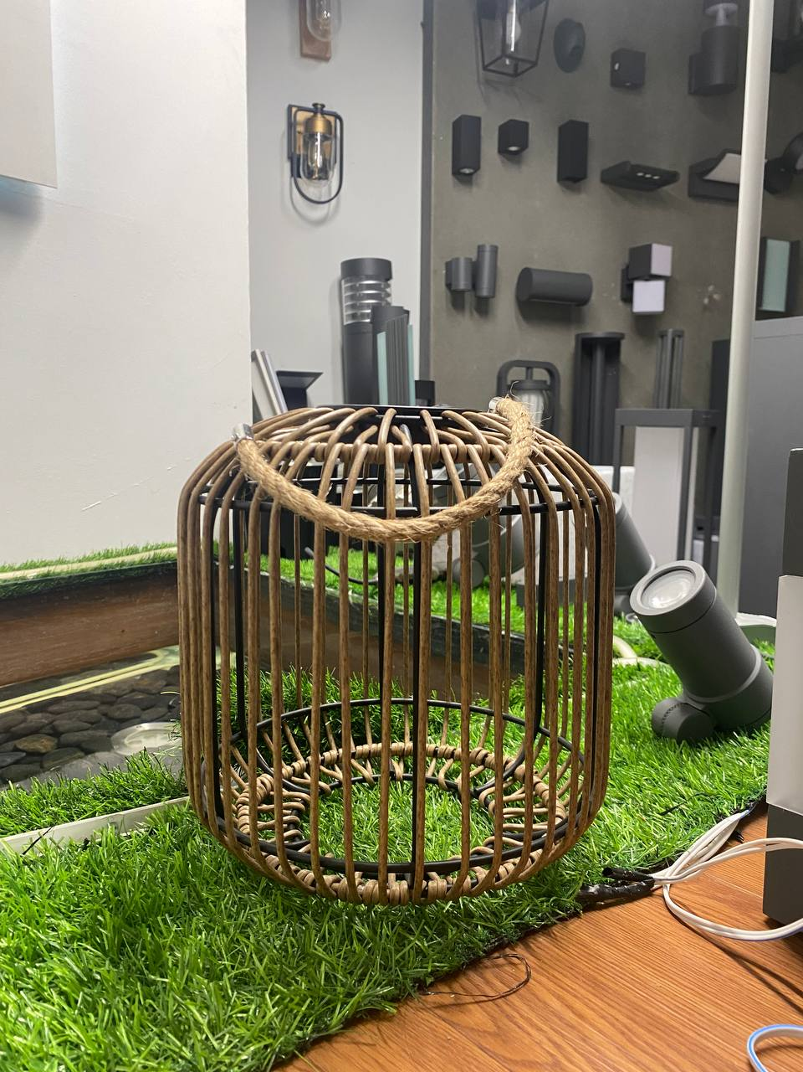
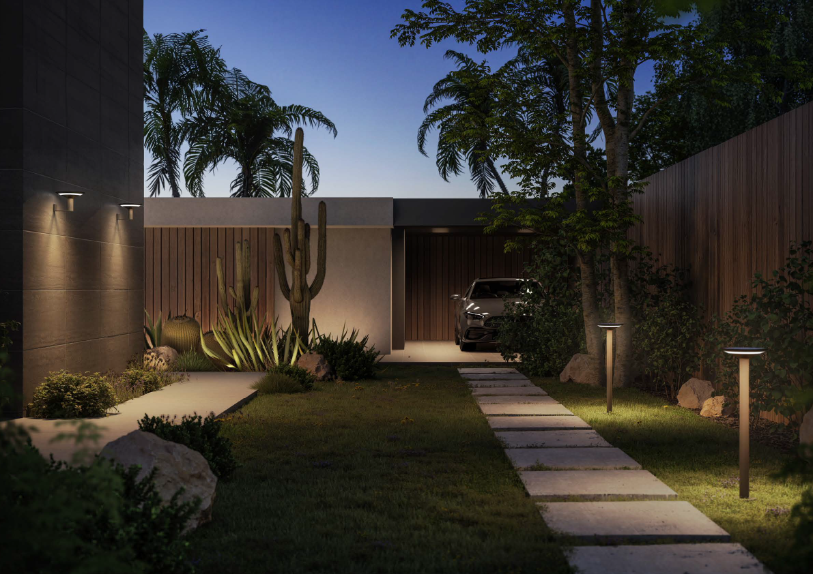
1120210
KEOPE WALL LED SOLAR LAMP DIE CAST ALUMINUM POWDER COATED TO DARK GREY
LIGHT SOURCE : 3W
CHIP : Lumileds 4014
COLOR TEMP : 3000K
LUMEN : 231Lm - 100%
WORKING TEMP : -20˚C to 40˚C
CHARGING TIME : 10-12H
WORKING TIME : 23-25H
LITHIUM BATTERY : 4400mAh
SOLAR PANEL VOLTAGE : 3.5W 7V
CRI : Ra 80 IP : IP65
SIZE : Ø218 x H135mm

Slide 5
1120110
KEOPE BOLLARD LED SOLAR LAMP KLEWE
LIGHT SOURCE : 3W
CHIP : Lumileds 4014
COLOR TEMP : 3000K
LUMEN : 270Lm - 100%
WORKING TEMP : -20˚C to 40˚C
CHARGING TIME : 10-12H
WORKING TIME : 23-25H
LITHIUM BATTERY : 4400mAh
SOLAR PANEL VOLTAGE : 3.5W 7V
CRI : Ra 80 IP : IP65
SIZE : Ø205 x H800mm

Slide 6
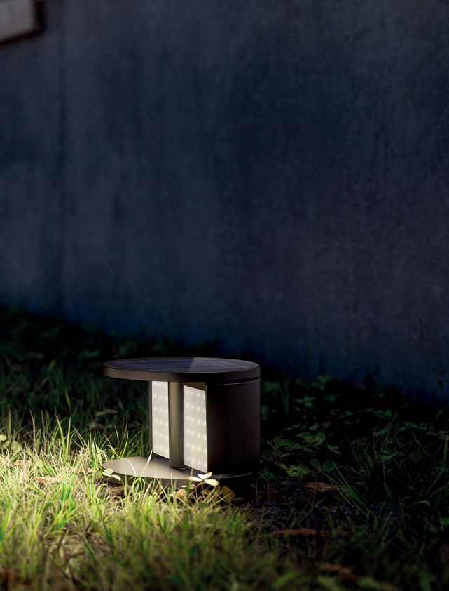
1220110
SWING GROUND LED SOLAR LAMP KLEWE
LIGHT SOURCE : 3W
CHIP : Lumileds 4014
COLOR TEMP : 3000K
LUMEN : 160Lm - 100%
WORKING TEMP : -20˚C to 40˚C
CHARGING TIME : 10-12H
WORKING TIME : 23-25H
LITHIUM BATTERY : 4400mAh
SOLAR PANEL VOLTAGE : 3W 7V
CRI : Ra 80 IP : IP65
SIZE : Ø200 x H144mm

Slide 7
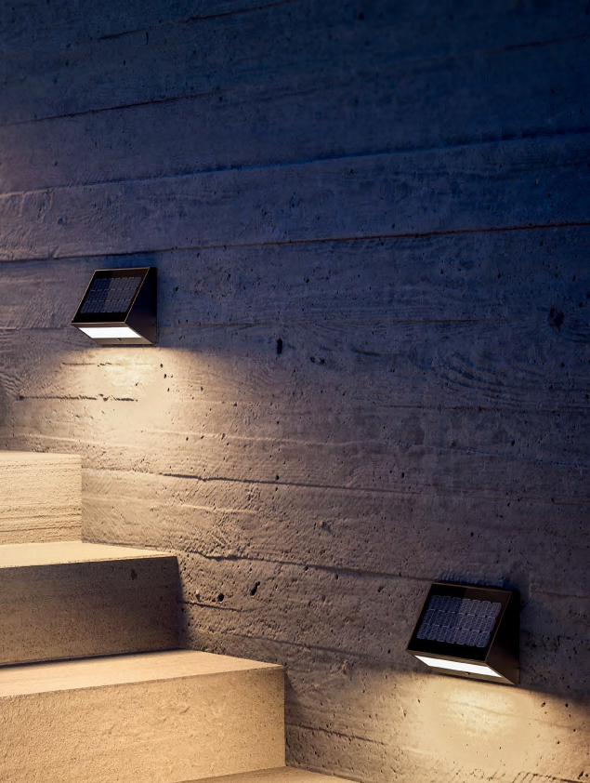
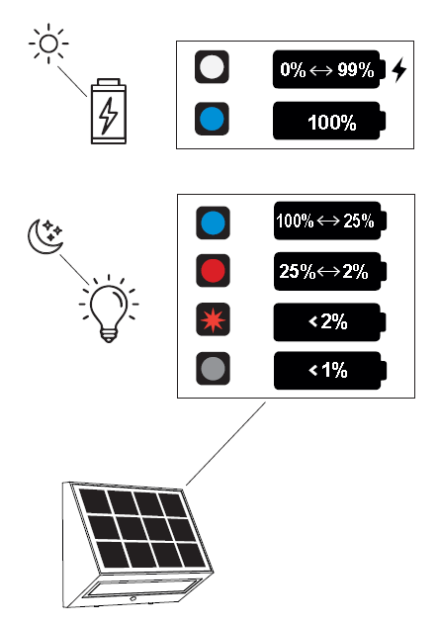
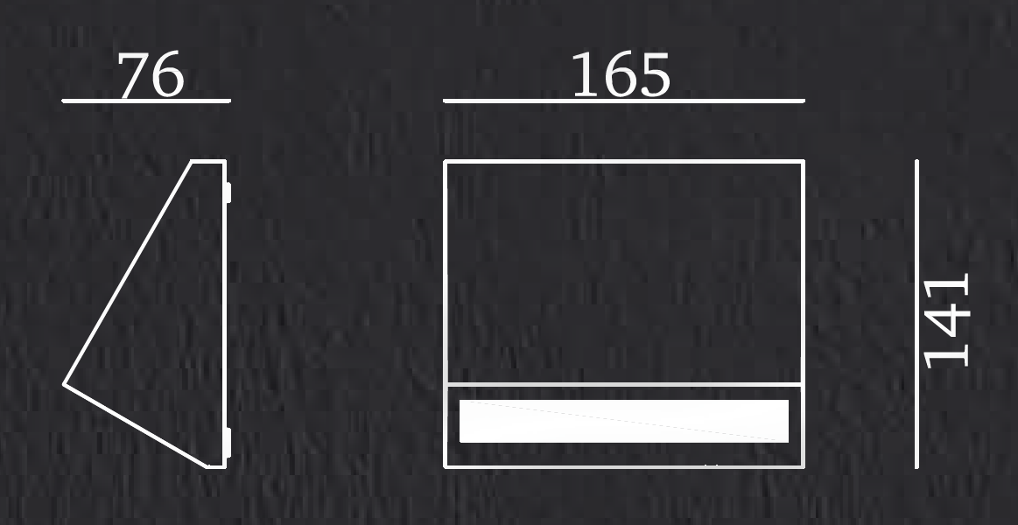
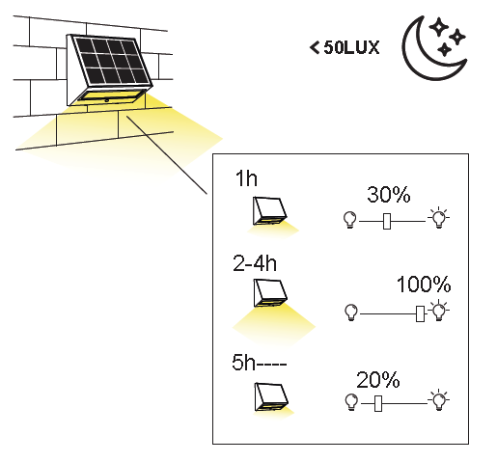
1110110
ECOSTEP WALL LED SOLAR LAMP DIE CAST ALUMINUM POWDER COATED TO DARK GREY
LIGHT SOURCE : 2.2W
CHIP : Lumileds 4014
COLOR TEMP : 3000K
LUMEN : 200Lm - 100%
WORKING TEMP : -20˚C to 40˚C
CHARGING TIME : 6-8H
WORKING TIME : 13-15H
LITHIUM BATTERY : 2200mAh
SOLAR PANEL VOLTAGE : 2.5W 7V
CRI : Ra 80 IP : IP65
SIZE : 76 x 165 x H141mm

